Slide 1
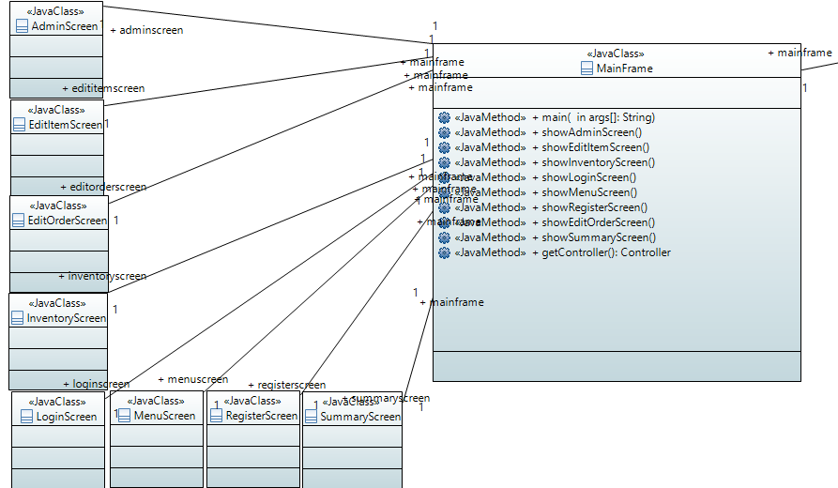
Final Class Diagram

Slide 2
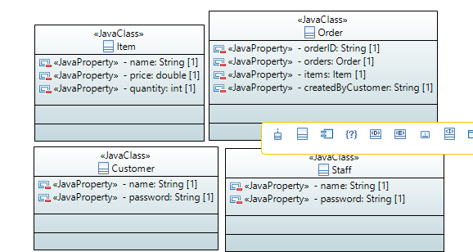
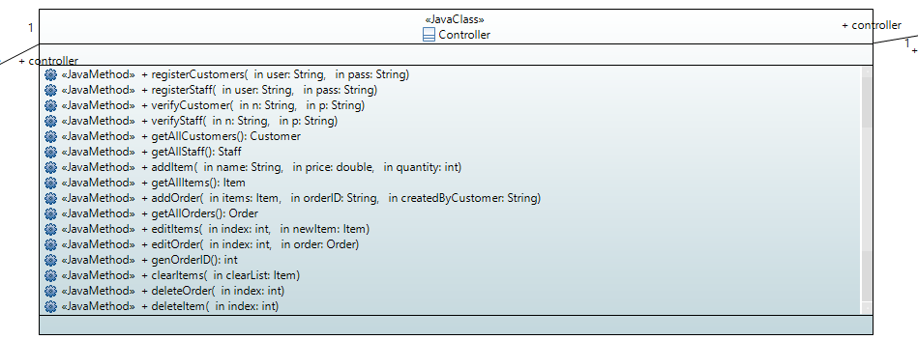
Final Class Diagram

Slide 3
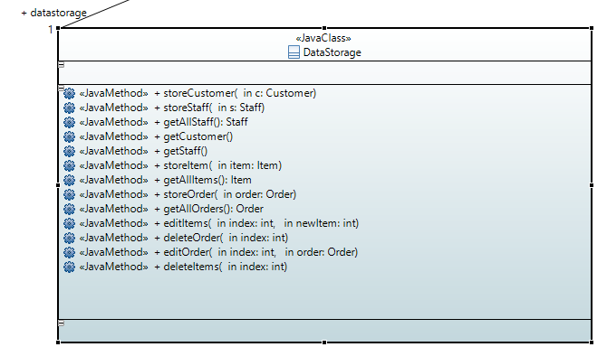
Final Class Diagram

Slide 4
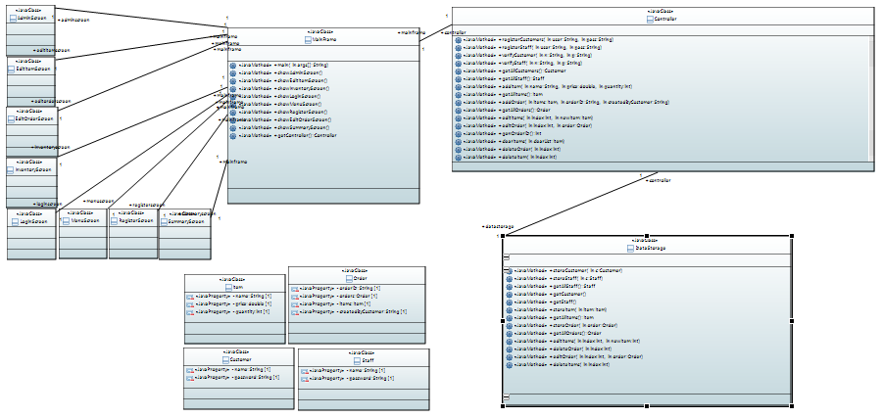
Final Class Diagram

Slide 5
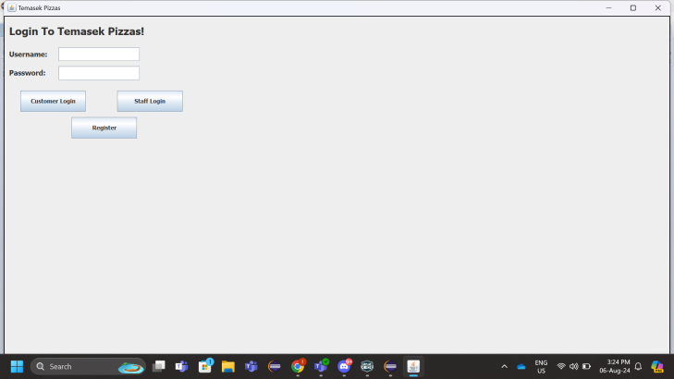
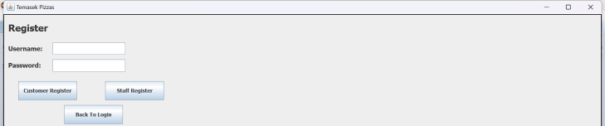
Final Story Board (Project Screenshots)
Login Screen
Register Screen

Slide 6
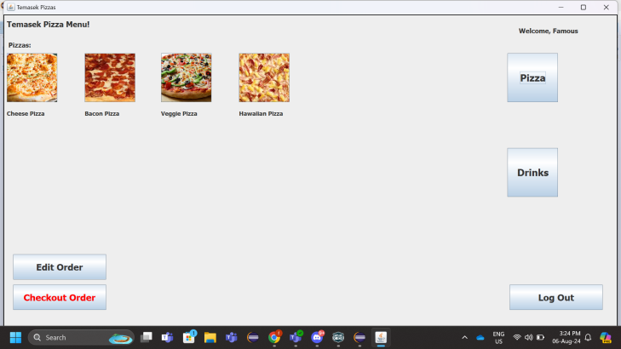
Final Story Board (Project Screenshots)
Menu Screen

Slide 7
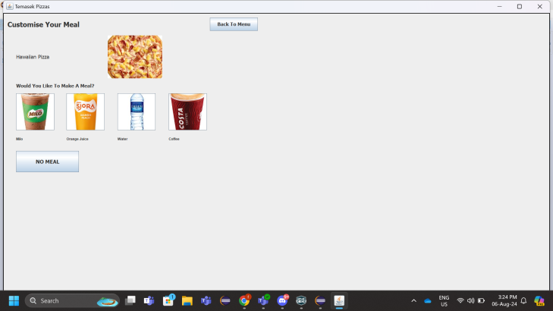
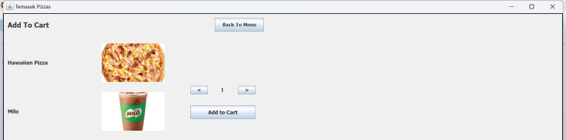
Final Story Board (Project Screenshots)
Customise Meal Screen
Add To Cart Screen

Slide 8
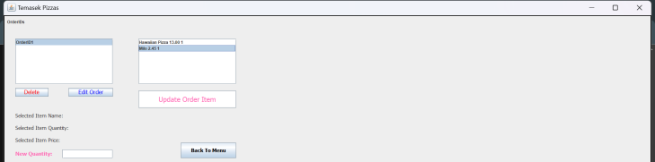
Final Story Board (Project Screenshots)
Edit Order Screen

Slide 9
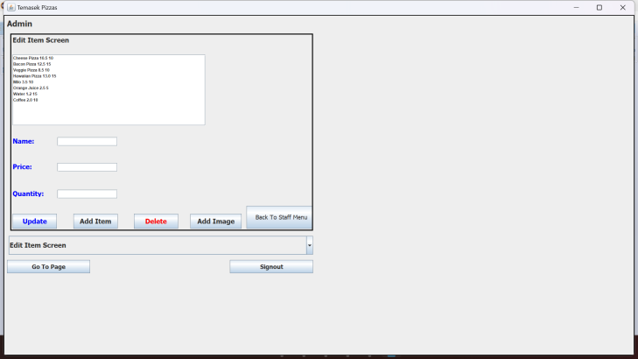
Final Story Board (Project Screenshots)
Admin Screen

Slide 10
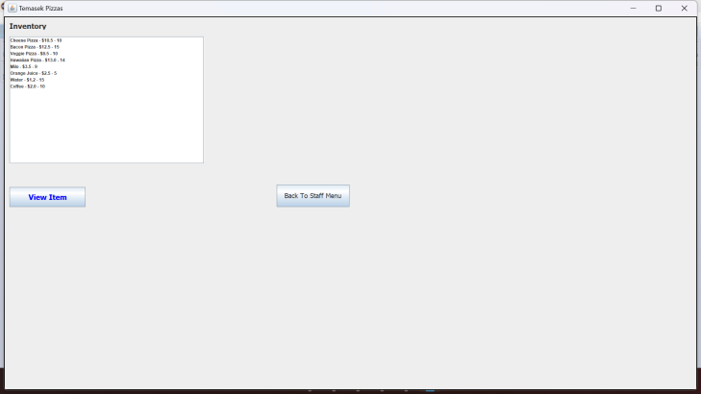
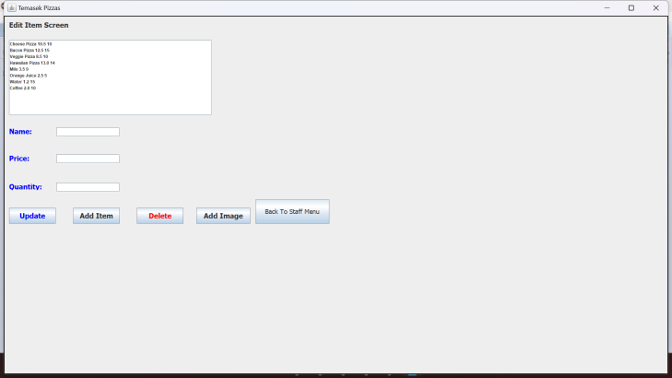
Final Story Board (Project Screenshots)
Inventory Screen
Edit Item Screen

Slide 11
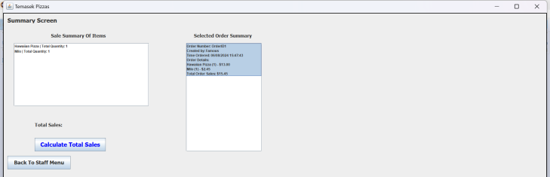
Final Story Board (Project Screenshots)
Summary Screen

